Slide 1
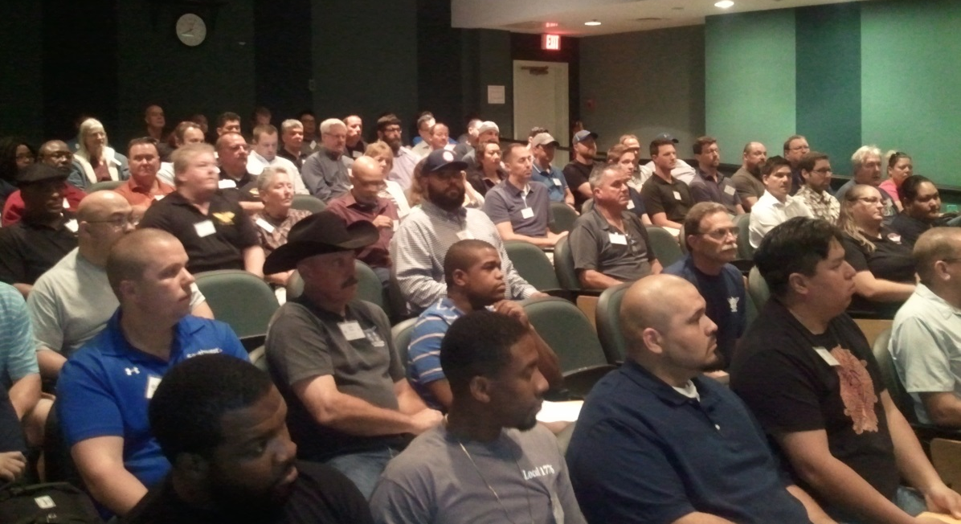
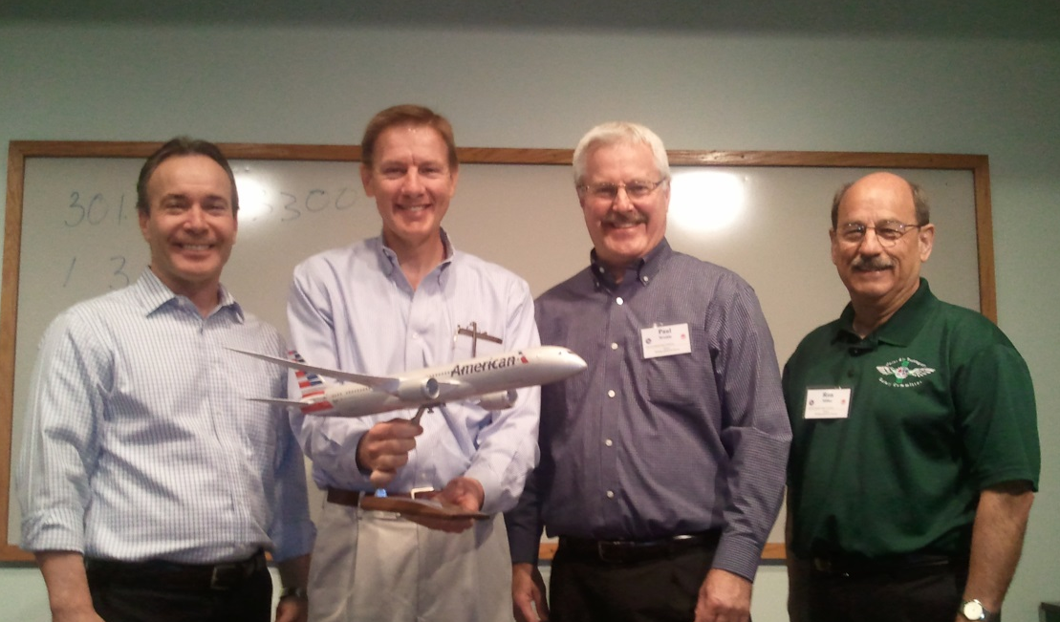
Safety Working together for Success
2017 IAM Ground Safety Training Conference
Notes:
Opening of Conference … American Airline's Executives presenting W3 Educational Director Chris Wagoner with Aircraft Model for display at facility.

Slide 2
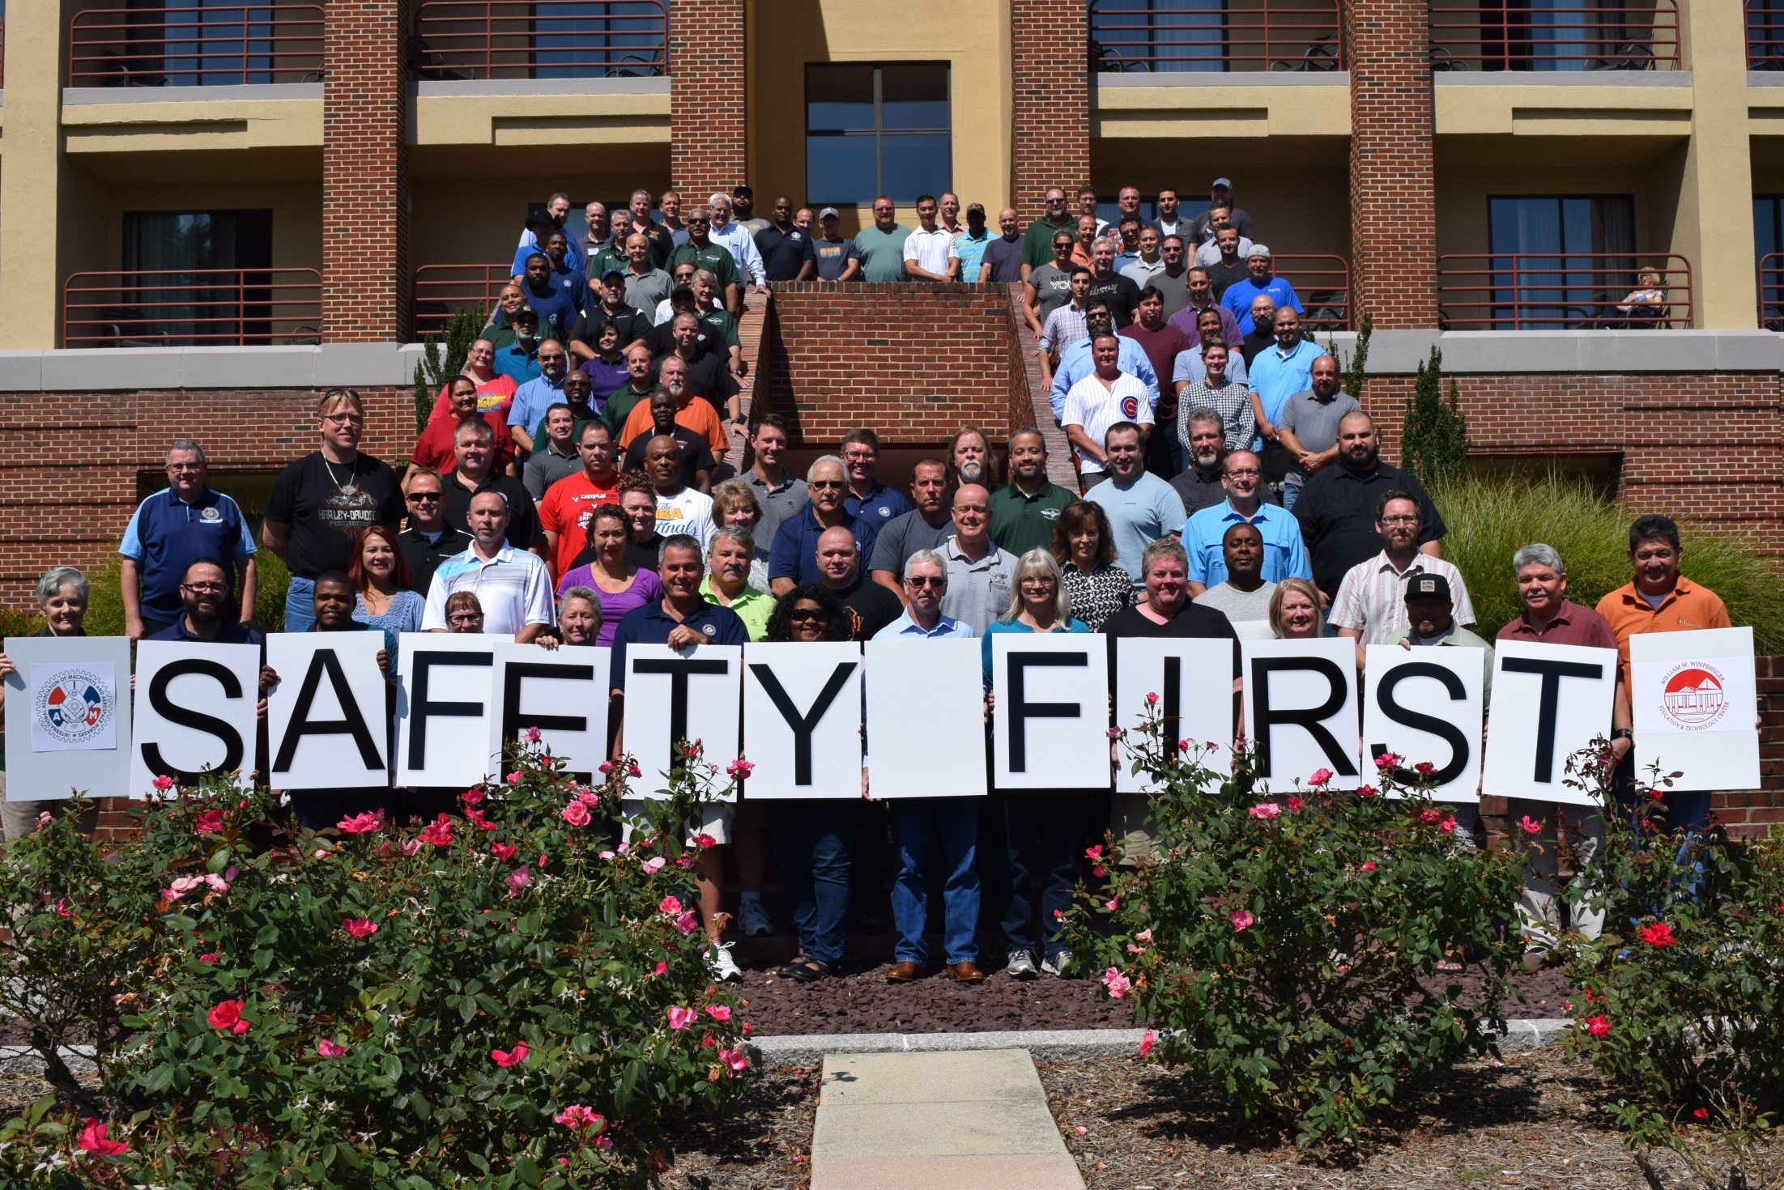
Notes:
Group Photo of Attendees … 2017 Ground Safety Conference

Slide 3
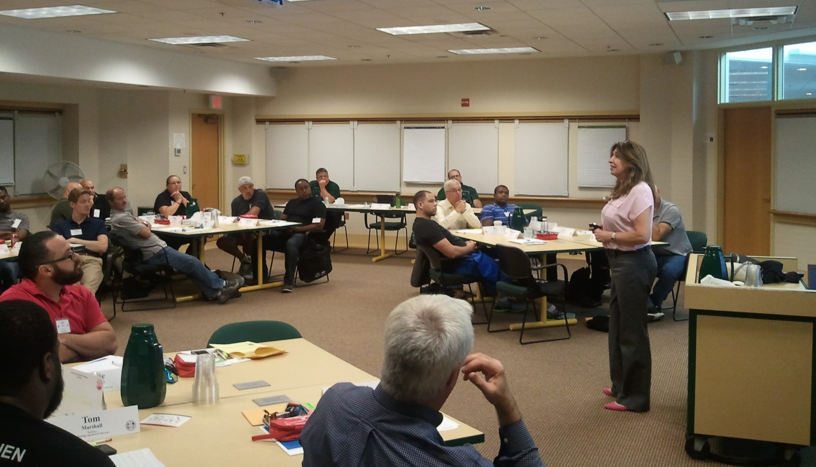
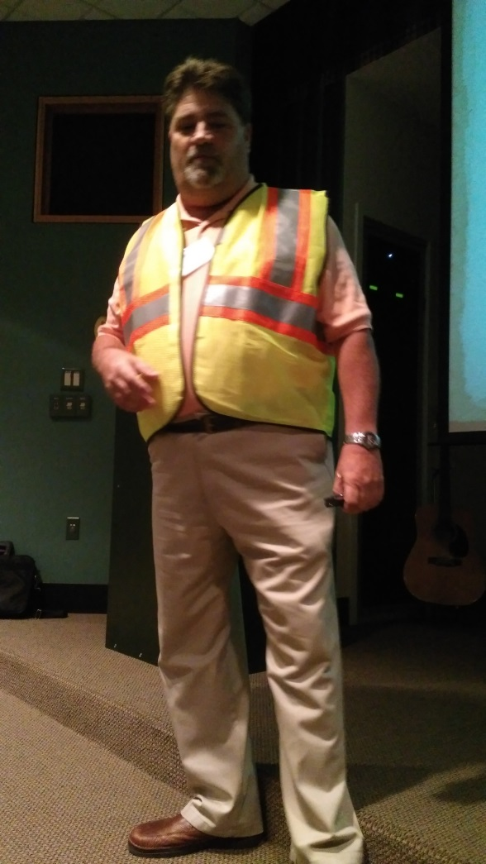
Notes:
Instructor Mike Harnett from 6 Safety Systems and Brett Beal from OSHA

Slide 4
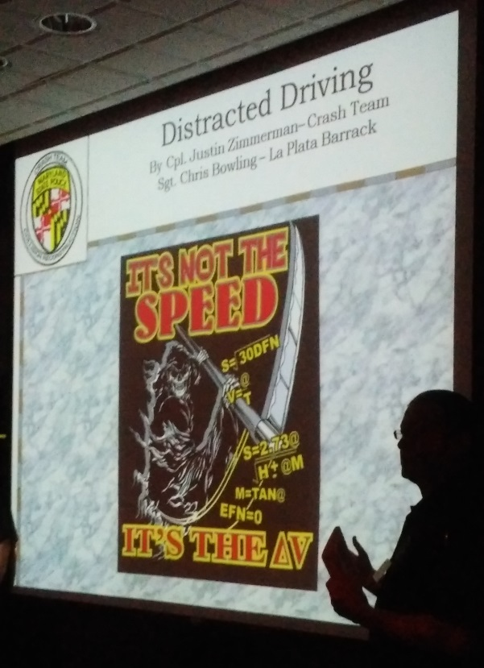
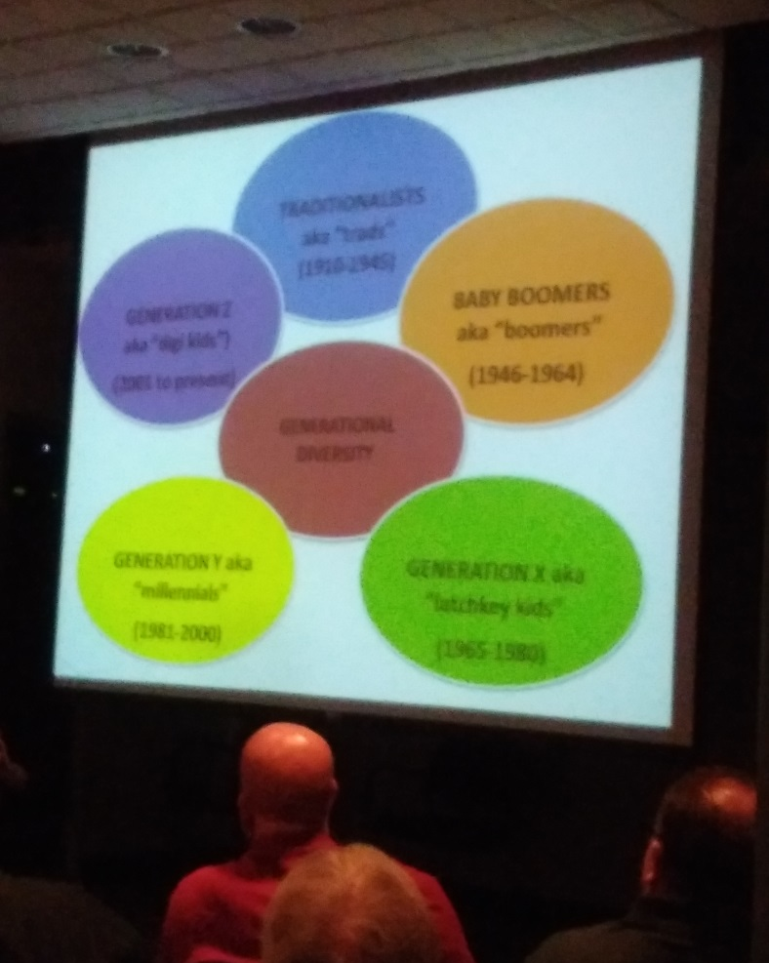
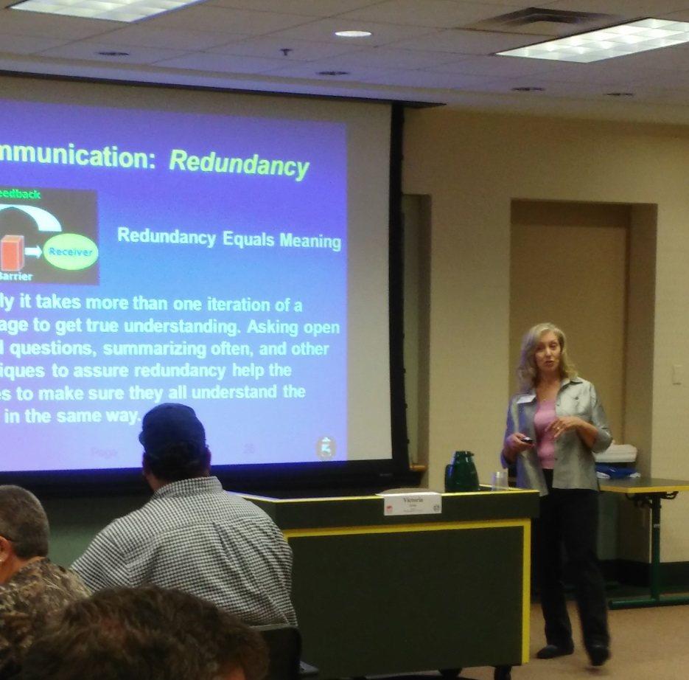
Notes:
Instructor Presentations

Slide 5
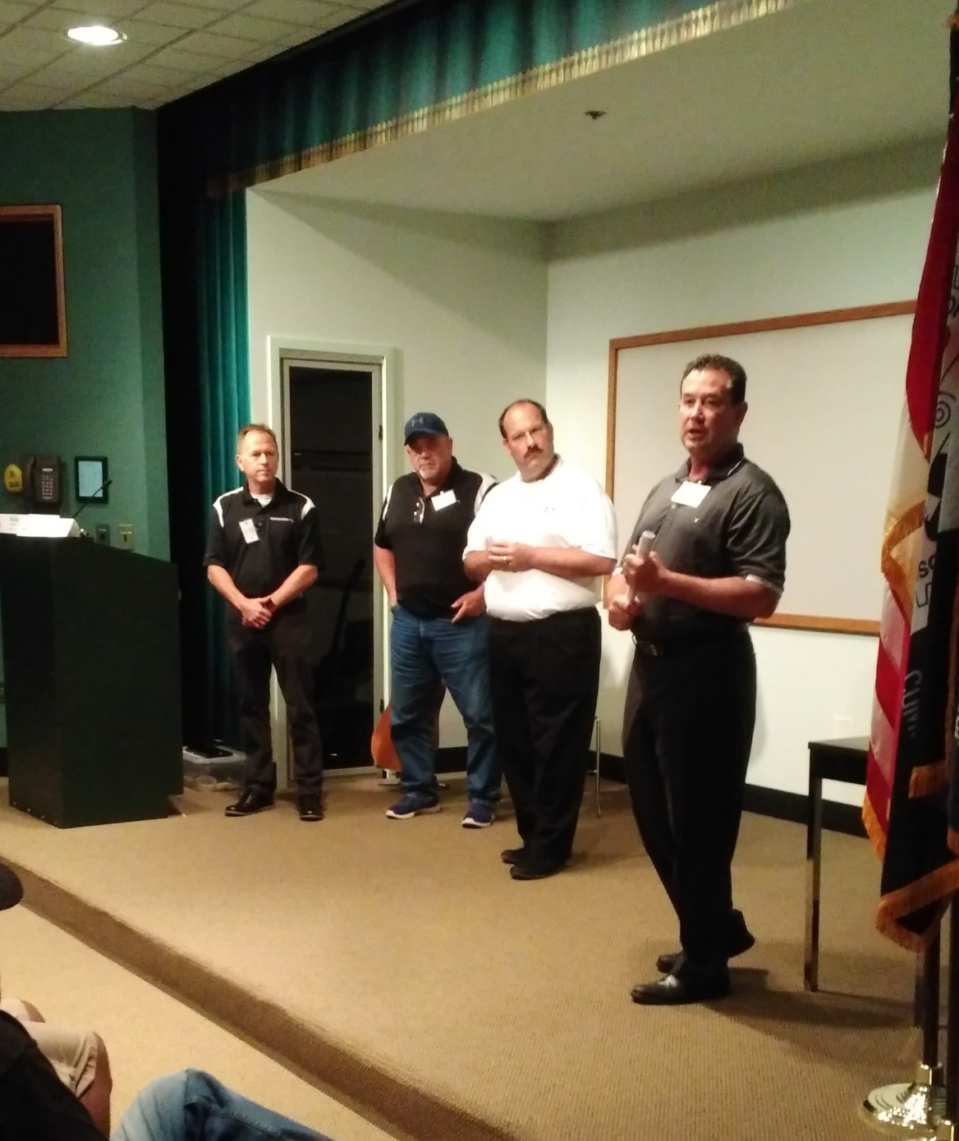
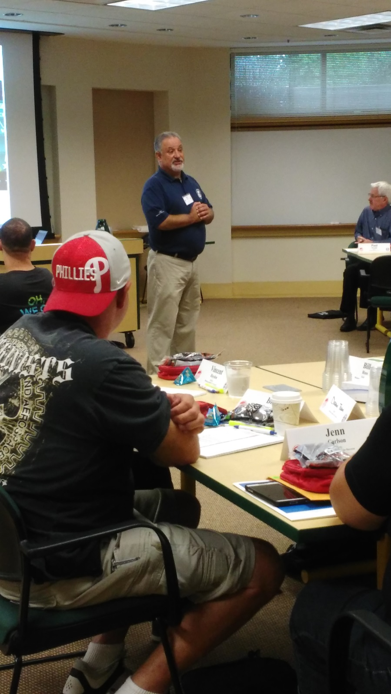
Notes:
Instructors interacting with participants

Slide 6
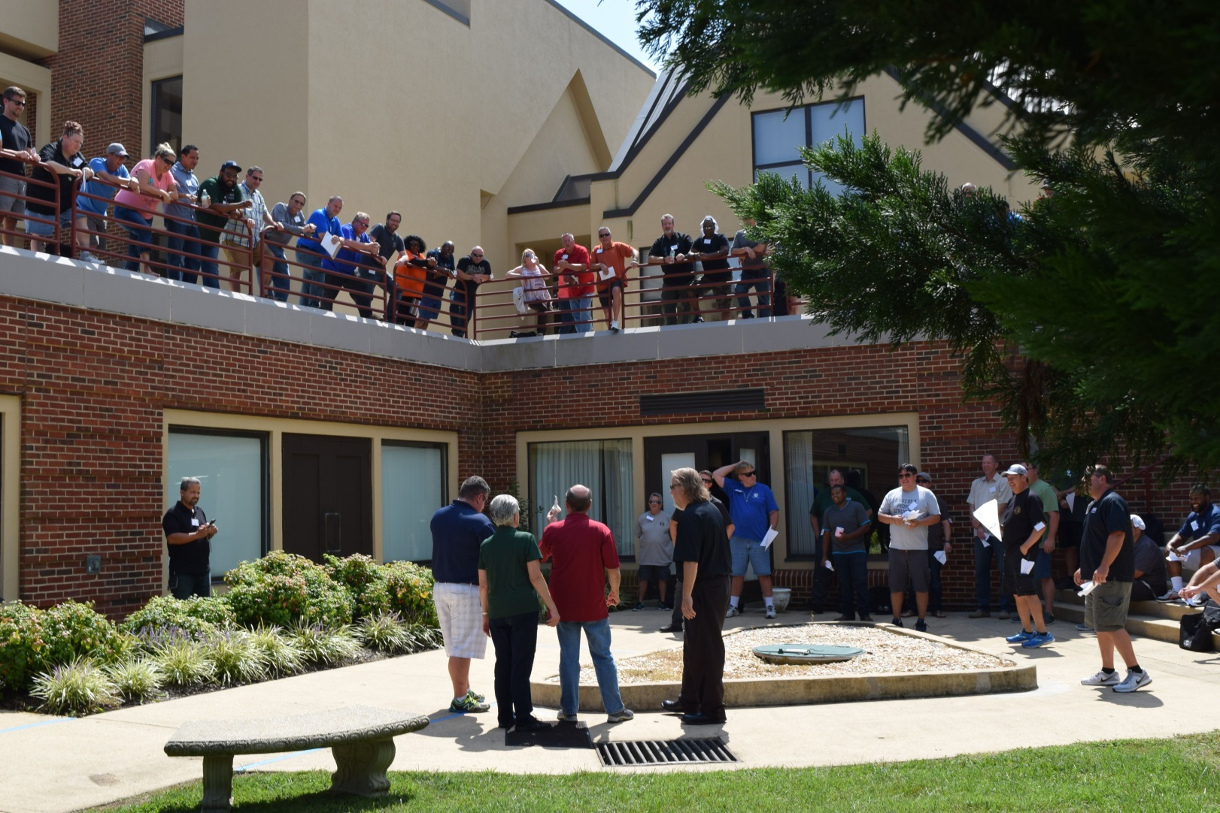
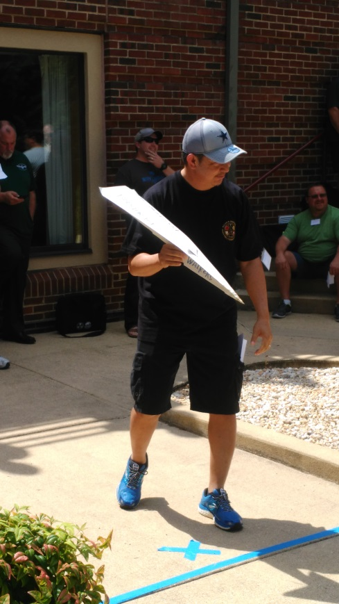
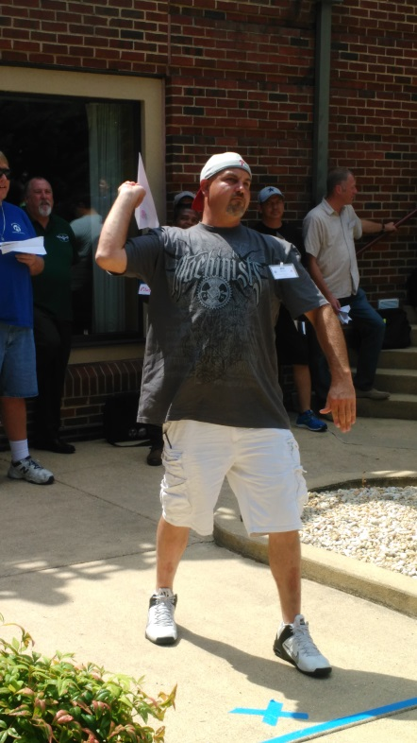
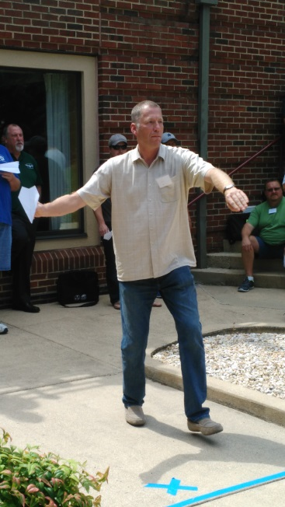
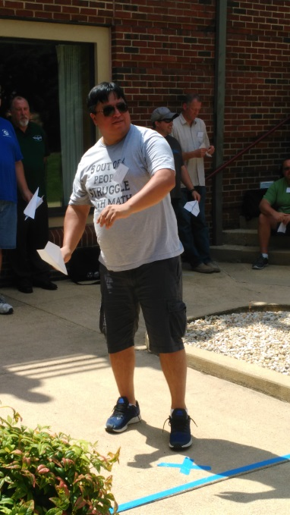
Notes:
Team Building Exercise Competition

Slide 7
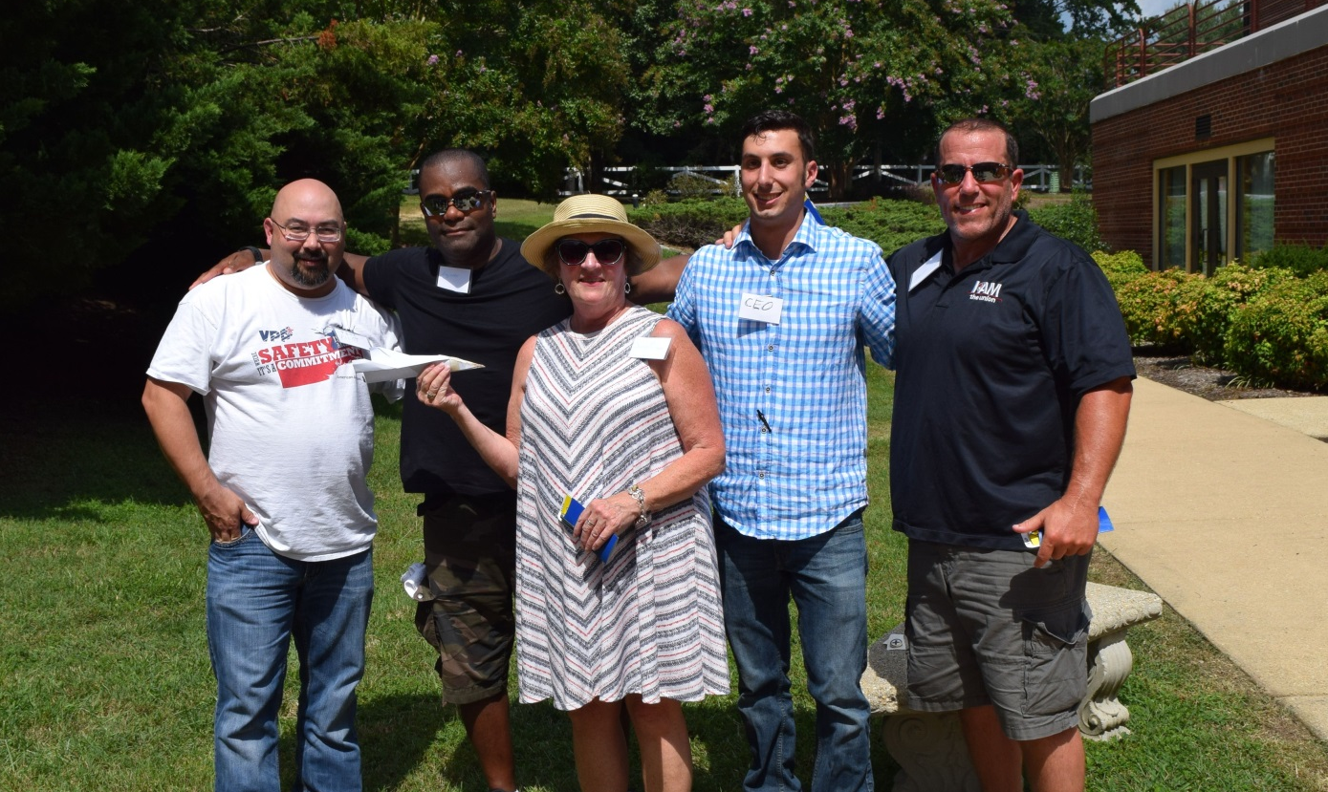
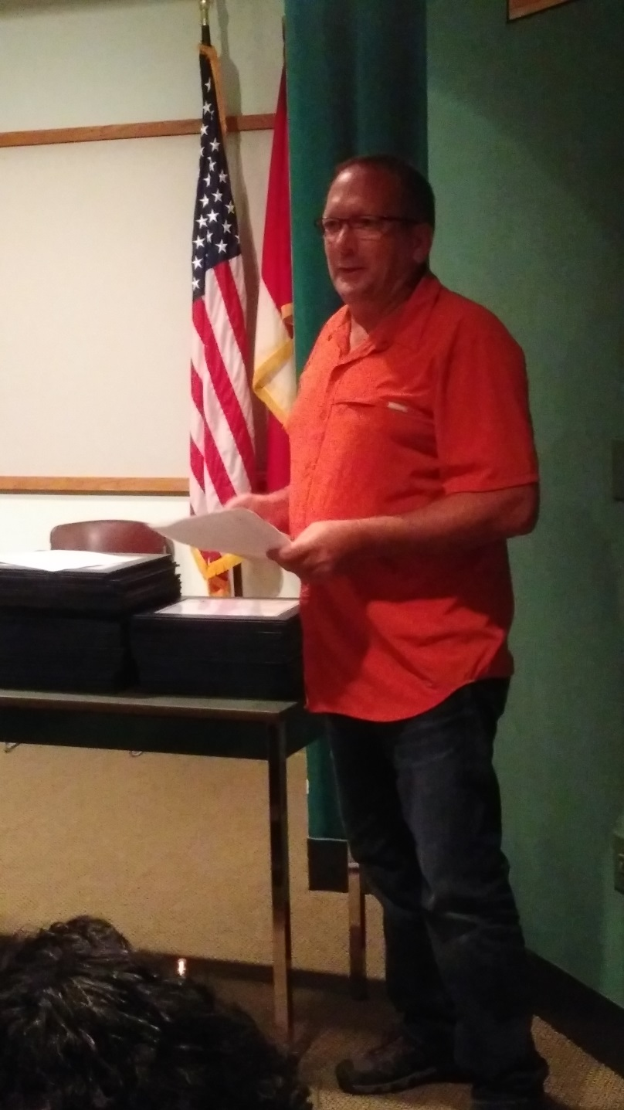
Notes:
Competition Winning Team … Team Building reports

Slide 8
2018 IAM Ground Safety Training Conference
August 28, 29, 30
Safety learn it, Live it, Share it
Notes:
2018 Theme for Conference

